Slide 1
SENTIMENT CLASSIFICATION TECHNIQUES FOR ARABIC LANGUAGE: A SURVEY
Mariam Biltawi, Wael Etaiwi, Sara Tedmori, Amjad Hudaib and Arafat Awajan

Slide 2
Abstract
Sentiment analysis
aims to determine the overall sentiment orientation of a speaker or writer towards a specific entity or towards a specific feature of a specific entity
A fundamental task of it, is sentiment classification, which aims to automatically classify opinionated text as being positive, negative, or neutral.
The main goal of this paper is:
To provide a comprehensive survey of existing machine learning and lexicon based sentiment classification techniques for Arabic language

Slide 3
Content
Introduction
Sentiment Analysis
Corpora and Lexicon
Lexicon-base approach
Machine learning classifiers
Discussion
Conclusion

Slide 4
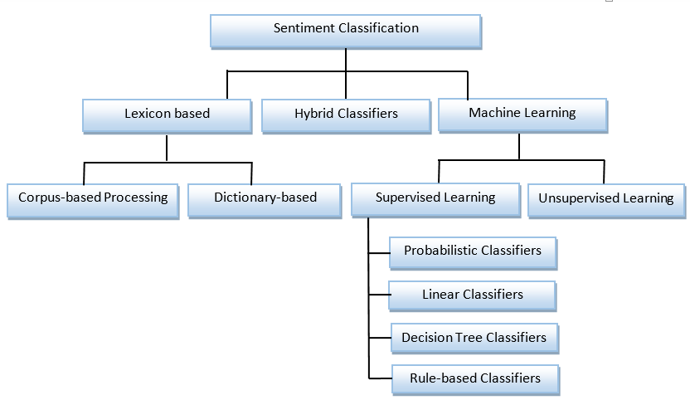
Introduction

Slide 5
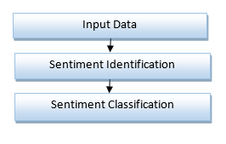
Sentiment Analysis

Slide 6
Corpora and Lexicon
The supervised and lexicon-based techniques for SC are dependent on having either a corpus or a lexicon.
A corpus is a dataset of labeled reviews or text that is used by the supervised technique to train classifiers in order to predict the sentiment of unseen reviews.
A lexicon is a dictionary of words labeled with its sentiment value as positive, negative or neutral.
The hybrid technique tries to enhance the accuracy of the classifiers using lexicon.

Slide 7
Corpora and Lexicon
Available Lexicons:
ArSenL: large-scale Arabic Sentiment Lexicon is the first publicly available lexicon, constructed using a combination of English SentiWordnet (ESWN), Arabic WordNet, and the Arabic Morphological Analyzer (AraMorph).
SLSA: Standard Arabic Sentiment Lexicon is another publicly available lexicon, constructed by linking the lexicon of AraMorph with SentiWordNet along with a few heuristics and powerful back-off.

Slide 8
Corpora and Lexicon
Available Corpora’s:
ASTD: The Arabic social sentiment analysis dataset, consists of 10000 Arabic tweets, manually classified into objective, subjective positive, subjective negative, and subjective mixed.
AWATIF is a multi-genre, multi-dialect manually built corpus for Arabic Subjectivity and SA, extracted from three different resources: the Penn Arabic Treebank (PATB), Wikipedia user talk pages, and conversation threads from web forums of seven different sites.
LABR: the Large-scale Arabic Book Review dataset which consists of over 63,000 book reviews each with a rating of 1 to 5 stars.
HAAD: The first aspect-based SA dataset for Arabic language is human annotated Arabic dataset (HAAD), consists of human annotated Arabic books reviews with aspect terms and their polarities.

Slide 9
Lexicon-base approach
Lexicon-based SC: an unsupervised approach, consists of two main categories;
dictionary-based,
corpus-based

Slide 10
Machine Learning Classifiers
Machine Learning classifiers
Probabilistic Classifiers
Naïve Bayes (NB)
Maximum Entropy Classifier (ME)
Linear Classifiers
Decision Tree Classifiers
Rule-Based Classifiers

Slide 11
Table of Articles Summary
Table 1 : Articles summary
Ref. | Year | Task | Domain-Oriented | Algorithm-Used | Polarity | Data Scope | Type | Accuracy
[31] | 2009 | SA | N | Decision Tree classifiers | G | Arabian scientific encyclopedia/ prophetic traditions or 'Hadiths' | MSA | scientific corpus: 93% literary corpus: 91%
[17] | 2010 | SC | N | Dictionary-based | Pos/Neg | Arabic movies | MSA | grammatical approach: 89.3% semantic Approach: 62% document level approach: 87%
[18] | 2010 | SA | N | Corpus-based | Pos/Neg | Arabic Business Reviews | Arabic | N/A
[30] | 2010 | SA | Y | SVM, NLP and Bayes Point Machine (BPM) | Pos/Neg | Hadith | MSA | 96%
[22] | 2011 | SA | N | Corpus-based | Pos/Neg | Newswire | MSA | N/A
[24] | 2012 | SC | N | Probabilistic classifier | Pos/Neg | Arabic Facebook Posts (Social Networks) | Syrian, Egyptian, Iraqi and Lebanese dialects, | Naïve Bayes: 83.4 % Naïve Search: 91.2%
[26] | 2012 | SA | N | Probabilistic Classifiers | Pos/Neg | Arabic news text | MSA | 29.93 % - 85.52
[35] | 2012 | SC | N | ML | Pos/Neg | Arabic Twists | MSA / Colloquial Arabic. | 72.6%
[13] | 2013 | SA | Y | Dictionary-based | Pos/Neg | 72 social and news sites | MSA/Egyptian, Iraqi, Jordanian, Lebanese, Saudi, Syrian Dialects | 90%
[28] | 2013 | SC | Y | Linear Classifiers | Pos/Neg | Arabic youth news‟ comments on Facebook | Arabic slang language | 88.63%
[33] | 2013 | SA | N | Rule-based Classifiers | Pos/Neg | Arabic movie reviews, | MSA | N/A
[12] | 2014 | SA | N | Dictionary-based | Pos/Neg | Maktoob/ Twitter | MSA/Different Dialects | 74.6%
[14] | 2014 | SA | Y | Dictionary-based | G Pos/Neg | 72 social and news sites | MSA/ Egyptian, Iraqi, Jordanian, Lebanese, Saudi, Syrian Dialects | subjectivity algorithm: 93.9% polarity algorithm: 90% Strength/ Intensity Algorithm: 96.6%
[20] | 2014 | SA | N | Corpus-based | Pos/Neg | Arabic Tweets | MSA/ Jordanian dialect/ Arabizi | 76.78%
[25] | 2014 | SA | N | ML (NB, k-nearest neighbor (KNN) and SVM) | Pos/Neg | Arabic Twists and comments | MSA / Colloquial Arabic. | NB: 66.20 % SVM: 75.25% KNN: 70.97%
[32] | 2014 | SA | Y | ML (decision tree, SVM and NB) | Pos/Neg | Arabic YouTube pages | N/A | 94.5%
[34] | 2014 | SA | N | Rule-based Classifiers | Pos/Neg | Arabic documents | MSA / Colloquial Arabic. | 21% - 57%
[19] | 2015 | SA | N | Corpus-based | Pos/Neg | Arabic Tweets/ Product reviews/ TV Program Comments/ Hotel Reservation | MSA/ Egyptian Dialect | 95%
[21] | 2015 | SA | N | Dictionary-based | Pos/Neg | Arabic Tweets | Arabic | 67.3%
[23] | 2015 | SA | N | Corpus-based | Pos/Neg | Arabic Tweets | Syrian Dialect | 66.57%
[15] | 2015 | SA | N | NLP | Pos/Neg | Arabic Reviews | MSA | N/A
[16] | 2015 | SC | Y | NLP | Pos/Neg | Arabic Text | MSA/ Egyptian, Iraqi, Jordanian, Lebanese, Saudi, Syrian Dialects | 69.3%
[27] | 2015 | SA | Y | ML | Pos/Neg | Arabic tweets (textual & Audio) | MSA / Colloquial Arabic. | Bagging Technique: 85.95% Boosting Technique: 69.25%
[29] | 2015 | SA | Y | Linear Classifiers | Excellent, very good, middling, weak and horrible | comments collected from Trip Advisor website | MSA | N/A

Slide 12
Conclusion
About 24 papers were surveyed
SC were categorized into three main techniques; the lexicon-based, ML and hybrid techniques.
The interest in Arabic language processing raised in the last 5 years.
Twitter is the most frequently used data source in Arabic SA
The most common ML algorithms used to classify Arabic sentiments are NB and SVM.
Arabic SA and SC are still an open area for research.

Slide 13
Thank You
Mariam Biltawi , Wael etaiwi

